Slide 1
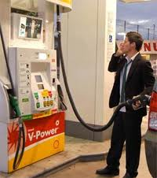

What Affects Gas Prices?
Click for sound!
Diana Rdzanek
Energy Law
Professor Bosselman
December 7, 2010

Slide 2

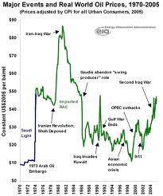
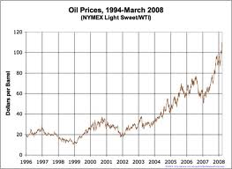
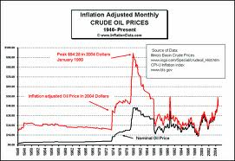

Gas prices are always changing, but why? I’ll bet this helpful power point presentation will tell me more!

Slide 3
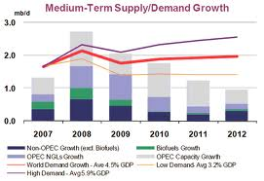
Major Factors that Affect Oil Prices
Economic Factors
Environmental Factors
Political Factors
Other Factors
Notes:
- Gas prices have changed significantly over the past year as a number of factors have affected the price of crude oil which directly impacts the price at the pump. Many Americans complain of high gas prices, however it is important to understand that pricing differs all over the world and in both Canada and Europe gas is significantly more expensive than in the United States. Understanding what affects gas prices can sometimes be a complex matter as there are numerous factors that go-into determining the final price of gasoline.

Slide 4
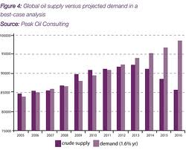
Economic Factors
Supply and Demand
Prices of commodities depend on supply and demand
  This particularly applies to finite resources like oil
But what changes supply and demand?
Notes:
Supply and demand are very relevant factors when looking at the price of any finite resource and this particularly applies to gas. OPEC is the organization in control of a majority of the world’s oil and thus plays a pivotal role in regulating the supply – and in many ways, the price of oil.
Interaction between demand and supply for oil Interaction between demand and supply for oil ultimately determines the oil price in the long run ultimately determines the oil price in the long run Special features of the oil market make the Special features of the oil market make the modelling exercise quite complex modelling exercise quite complex Various types of uncertainties Various types of uncertainties Due to unknown future events such as geopolitical Due to unknown future events such as geopolitical factors, supply disruptions, environmental disasters, factors, supply disruptions, environmental disasters, technological breakthroughs technological breakthroughs Due to lack of knowledge about factors such as the Due to lack of knowledge about factors such as the long run price and income elasticity of demand, the long run price and income elasticity of demand, the response of non response of non- -OPEC and OPEC behaviour OPEC and OPEC behaviour

Slide 5
Economic Factors
Global Oil Demand
  Oil demand is a function of income and price
  Demand does not change quickly, especially in the short run
Projections for Oil Demand
  Look at the relationship between oil demand, prices, and income to project future oil demand growth
Sound 1
Sound 2
Notes:
Oil demand as function of income and price Oil demand as function of income and price Oil demand and price usually examined within context of Oil demand and price usually examined within context of price elasticity of demand price elasticity of demand Measures relationship between the change in quantity of oil Measures relationship between the change in quantity of oil demanded and change in oil price demanded and change in oil price Wide variation in estimates Wide variation in estimates Some general observations Some general observations Changes in oil prices have small effect on demand especially in Changes in oil prices have small effect on demand especially in short run short run Long run price elasticity of demand higher than short one Long run price elasticity of demand higher than short one � � Due to substitution and energy conservation but elasticity still Due to substitution and energy conservation but elasticity still low low Price elasticity of demand higher in developed countries Price elasticity of demand higher in developed countries
Relationship between oil demand, prices & Relationship between oil demand, prices & income used to project oil demand growthincome used to project oil demand growth
Projections highly sensitive to assumptions Projections highly sensitive to assumptions made about economic growth scenarios made about economic growth scenarios Highly sensitive to income and price elasticity Highly sensitive to income and price elasticity Highly sensitive to oil price path chosen Highly sensitive to oil price path chosen Endogeneity Endogeneityof prices and income bias of prices and income bias results results Ignore potential relationship between oil price Ignore potential relationship between oil price increases and growthincreases and growth

Slide 6
Economic Factors
Global Oil Supply
  Modeling and predicting oil supply is much more complex
  Major uncertainties
    Geopolitical factors, supply chain disruptions, environmental disasters, technological breakthroughs
    Unpredictability of OPEC behavior and long-term price and income information affecting demand
    Disagreement over the actual amount of reserves available
Notes:
Issue of reserves Issue of reserves Behaviour of various suppliers Behaviour of various suppliers Distinguish between OPEC and non Distinguish between OPEC and non- -OPEC OPEC Different and diverse suppliers outside OPEC ranging Different and diverse suppliers outside OPEC ranging from national oil companies, from national oil companies, IOCs IOCsand independents and independents Widely assumed that non Widely assumed that non- -OPEC behaves OPEC behaves competitively competitively OPEC behaviour much more complex OPEC behaviour much more complex � � Many diverse theories in literature ranging from cartel to Many diverse theories in literature ranging from cartel to competitive behaviour competitive behaviour
Various types of uncertainties Various types of uncertainties Due to unknown future events such as geopolitical Due to unknown future events such as geopolitical factors, supply disruptions, environmental disasters, factors, supply disruptions, environmental disasters, technological breakthroughs technological breakthroughs Due to lack of knowledge about factors such as the Due to lack of knowledge about factors such as the long run price and income elasticity of demand, the long run price and income elasticity of demand, the response of non response of non- -OPEC and OPEC behaviourOPEC and OPEC behaviour

Slide 7

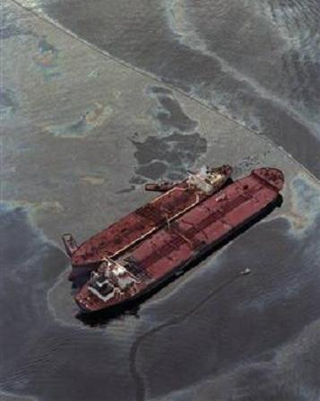
Economic Factors
Global Oil Supply: Role of OPEC
  OPEC acts as swing producer equilibrating demand and supply OPEC acts as swing producer equilibrating demand and supply with optimal prices/quantity levels with optimal prices/quantity levels
1
2
Notes:
The Organization of the Petroleum Exporting Countries (OPEC, pronounced /ˈoʊpɛk/ OH-pek) is a cartel of twelve developing countries made up of Algeria, Angola, Ecuador, Iran, Iraq, Kuwait, Libya, Nigeria, Qatar, Saudi Arabia, the United Arab Emirates, and Venezuela.
It also pursues ways and means of ensuring the stabilization of prices in international oil markets with a view to eliminating harmful and unnecessary fluctuations; giving due regard at all times to the interests of the producing nations and to the necessity of securing a steady income to the producing countries; an efficient and regular supply of petroleum to consuming nations, and a fair return on their capital to those investing in the petroleum industry.[4]

Slide 8
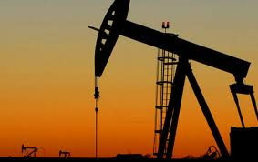
Economic Factors
Supply-Demand Limitations
  Hard to project oil prices in any economic framework
    Mistakes result from number of reasons
      Must make many assumptions
      Cannot predict unexpected shocks
      Non-neutral context
      Unpredictable environmental (part II) and political (part III) factors
Notes:
Using this framework to project oil prices is likely to result i Using this framework to project oil prices is likely to result in n mistakes for a number of reasons mistakes for a number of reasons highly sensitive to assumptions made about income and price highly sensitive to assumptions made about income and price elasticity of demand, the price elasticity of supply, role of elasticity of demand, the price elasticity of supply, role of reserves, OPEC behaviour reserves, OPEC behaviour Can not capture impact of unexpected shocks Can not capture impact of unexpected shocks � � Cashin Cashinel at al, 1999: 妬t is incorrect to view shocks to el at al, 1999: 妬t is incorrect to view shocks to commodity prices as generally being a temporary commodity prices as generally being a temporary phenomenon that largely reflect short phenomenon that largely reflect short- -lived variability in lived variability in supply interacting with relatively unchanging demand� supply interacting with relatively unchanging demand� Does not take into account general geopolitical context and Does not take into account general geopolitical context and market conditions in which oil prices are determined market conditions in which oil prices are determined � � Supply Supply- -demand framework analyses oil prices and makes demand framework analyses oil prices and makes projections in a 創eutral context� projections in a 創eutral context�

Slide 9



Environmental Factors
    Unpredictable geological and events can affect oil prices either positively or negatively
      Short-term and long-term impacts
      Two Examples:
        Increase oil prices: Hurricane Katrina
        Decrease oil prices: Eyjafjallajkull eruption

Slide 10
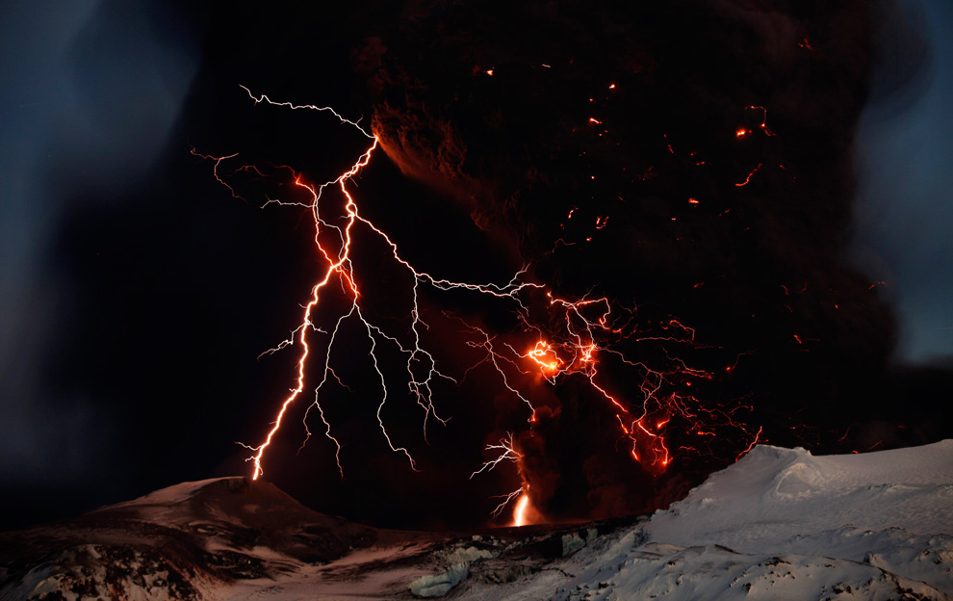
Environmental Factors
2010 eruptions of Eyjafjallajkull
  The Geological Event
    Seismic activity begins at end of 2009
    March 20, 2010: small eruption begins
    April 14, 2010: eruption enters second phase
      250,000,000 cubic meters of ash and tephra ejected intp atmosphere
    May 21, 2010: second phase subsides
    May 24, 2010: eruption is limited to water vapor
    October 2010: eruption declared officially over
Notes:
The 2010 eruptions of Eyjafjallajull are a timeline of volcanic events at Eyjafjl in Iceland which, although relatively small for volcanic eruptions, caused enormous disruption to air travel across western and northern Europe over an initial period of six days in April 2010. Additional localised disruption continued into May 2010. The eruption was declared officially over in October 2010, when snow on the glacier did not melt.Seismic activity started at the end of 2009 and gradually increased in intensity until on 20 March 2010, a small eruption started rated as a 1 on the Volcanic Explosivity Index.[1]Beginning on 14 April 2010, the eruption entered a second phase. The second phase of the eruption started on 14 April 2010 and resulted in an estimated 250 million cubic metres (330,000,000 cu yd) (ｼ km³) of ejected tephra. The ash plume rose to a height of approximately 9 kilometres (30,000 ft), which rates the explosive power of the eruption as a 4 on the Volcanic Explosivity Index.[2]
By 21 May 2010, the second eruption phase had subsided to the point that no further lava or ash was being produced.By the morning of 24 May 2010, the view from the web camera installed on ﾞfsfell showed only a plume of water vapour surrounded by a blueish haze caused by the emission of sulphurous gases.
In October 2010, ﾁrmann Hkuldsson, a scientist at the University of Iceland Institute of Earth Sciences stated that the eruption is officially over, although the area is still geothermally active and might erupt again.[5]

Slide 11
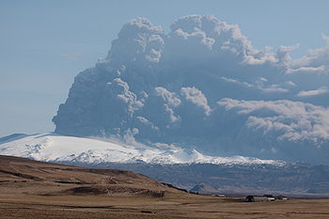
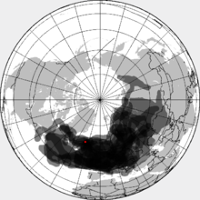
Environmental Factors
Composite map of volcanic ash cloud spanning
April 15 - April 25, 2010
Notes:
Composite map of the volcanic ash cloud spanning 14�25 April 2010

Slide 12

Environmental Factors
2010 eruptions of Eyjafjallajkull
  The Air Travel Disruption
    Volcanic ash is major hazard to aircraft
    Ash cloud leads to closure of most of Europe’s airspace
    Highest air travel disruption since the Second World War
Notes:
and created an ash cloud that led to the closure of most of Europe's IFR airspace from 15 until 20 April 2010. Consequently, a very high proportion of flights within, to, and from Europe were cancelled, creating the highest level of air travel disruption since the Second World War.
Volcanic ash is a major hazard to aircraft.[121] Smoke and ash from eruptions reduce visibility for visual navigation, and microscopic debris in the ash can sandblast windscreens and melt in the heat of aircraft turbine engines, damaging engines and making them shut down.[47][121] Many flights within, to, and from Europe were cancelled following the 14 April 2010 eruption, and although no commercial aircraft were damaged, the engines of some military aircraft were harmed.[122][123] The presence and location of the plume depends upon the state of the eruption and the winds. While some ash fell on uninhabited areas in Iceland, most had been carried by westerly winds resulting in the shut down of a large air space over Europe. The shut down had a knock on impact on the economy and cultural events across Europe.

Slide 13
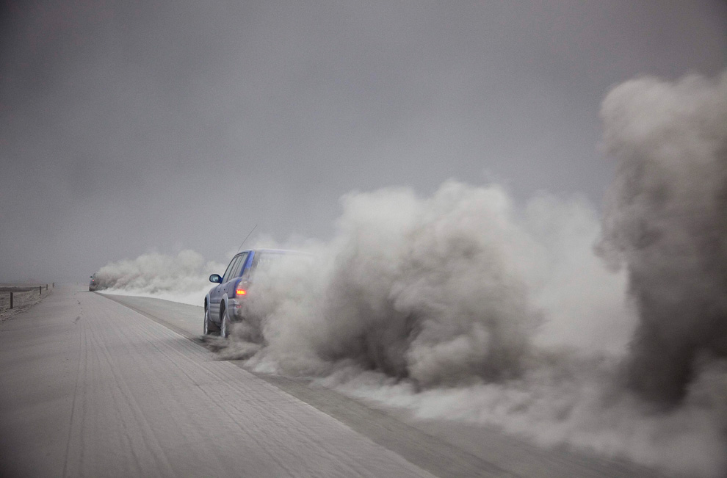
Environmental Factors
2010 eruptions of Eyjafjallajkull
  Effect on Oil Prices
    Unburnt fuel from canceled flights - changes supply and demand
      Consumption reduced by 1m barrels per day
      Jet fuel stockpile increases by 5m barrels
    Oil prices seesaw
Notes:
o More than 100,000 flights in and to/from Europe were grounded over a six-day period, with traffic expected to return to almost normal operations today (23-Apr-2010). IATA estimates that grounding aircraft halted USD110 million in other expenditures for airlines, much of that in unburnt fuel. Some estimates put the reduction in consumption at up to 1 million barrels per day, or 1-1.3% of global demand.

Slide 14
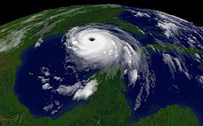
Environmental Factors
Hurricane Katrina
  The Weather Event
    August 23, 2010: Tropical Depression 10 forms over southeastern bahamas
    August 24, 2010: system upgraded to tropical storm and given the name “Katrina”
    August 25, 2010: system becomes Category 1 intensity hurricane, makes landfall in Florida
    Storm enters Gulf of Mexico, reaches Category 3
    August 27, 2010: hurricane doubles in size, and reaches Category 5.
    August 29, 2010: Katrina makes second landfall in Gulf of Mexico in Louisiana/Mississippi
Notes:
The storm rapidly intensified after entering the Gulf, growing from a Category 3 hurricane to a Category 5 hurricane in just nine hours. This rapid growth was due to the storm's movement over the "unusually warm" waters of the Loop Current, which increased wind speeds.[7] On Saturday, August 27, the storm reached Category 3 intensity on the Saffir-Simpson Hurricane Scale, becoming the third major hurricane of the season. An eyewall replacement cycle disrupted the intensification, but caused the storm to nearly double in size. Katrina again rapidly intensified, attaining Category 5 status on the morning of August 28 and reached its peak strength at 1:00 p.m. CDT that day, with maximum sustained winds of 175 mph (280 km/h) and a minimum central pressure of 902 mbar. The pressure measurement made Katrina the fourth most intense Atlantic hurricane on record at the time, only to be surpassed by Hurricanes Rita and Wilma later in the season; it was also the strongest hurricane ever recorded in the Gulf of Mexico at the time (a record also later broken by Rita).[2]Katrina made its second landfall at 6:10 a.m. CDT[2] on Monday, August 29 as a Category 3 hurricane with sustained winds of 125 mph (205 km/h) near Buras-Triumph, Louisiana. At landfall, hurricane-force winds extended outward 120 miles (190 km) from the center and the storm's central pressure was 920 mbar. After moving over southeastern Louisiana and Breton Sound, it made its third landfall near the Louisiana/Mississippi border with 120 mph (195 km/h) sustained winds, still at Category 3 intensity.[2]

Slide 15
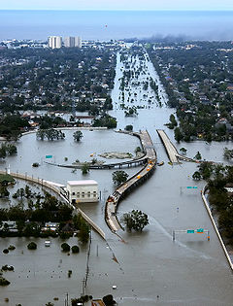
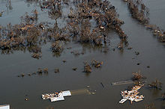
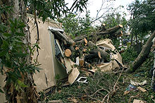
Environmental Factors
Hurricane Katrina
  The Fallout
    Storm interrupts production and importation
    Power outages cause distribution problems
    20 offshore platforms missing, sunk or adrift
Notes:
The storm interrupted oil production, importation, and refining in the Gulf eden, thus having a major effect on fuel prices. Before the storm, one-tenth of all the crude oil consumed in the United States and almost half of the gasoline produced in the country came from refineries in the states along the Gulf's shores. An additional 24% of the natural gas supply is extracted or imported in the region. Furthermore, the nation's Strategic Petroleum Reserve is also stored in this region.
At 7:03 a.m. CDT on August 29, Ted Falgout, Port Director of Port Fourchon, Louisiana, a key oil and gas hub 60 mi (100 km) south of New Orleans on the Gulf of Mexico, reported that the port had taken a direct hit from the hurricane. The port services approximately 16% of the nation痴 supply of crude oil and natural gas.[7] According to Falgout, Hurricane Katrina, "will impact oil and gas infrastructure, not just short term but long term as well. The impact of the storm � the Gulf is shut down; all of the area of the storm is shut down; a half billion dollars a day of oil and gas is unavailable."Port Fourchon takes direct hit from Katrina (7 a.m. CDT,29 August 2005)The Louisiana Offshore Oil Port, which imports 11% of all U.S. oil consumption, closed on August 27, and Shell reported a reduction in production of 420,000 barrels per day (67,000 m³/d).[8] The port was undamaged by the storm and resumed operation within hours of getting power back.

Slide 16
Large Oil Spills Caused by Hurricane Katrina
Spill location | Quantity
 | (US gal) | (L)
Bass Enterprises (Cox Bay) | 3.78 mil | 14.3 mil
Shell (Pilot Town) | 1.05 mil | 4 mil
Chevron (Empire) | 991 K | 3.75 mil
Murphy Oil (Meraux/Chalmette) | 819 K | 3.1 mil
Bass Enterprises (Pointe Hache) | 461 K | 1.75 mil
Chevron (Port Fourchon) | 53 K | 200 K
Venice Energy Services (Venice) | 25 K | 95 K
Shell Pipeline Oil (Naim) | 13 K | 51 K
Sundown Energy (West Potash) | 13 K | 49 K

Slide 17
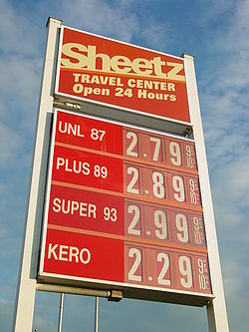
Environmental Factors
Hurricane Katrina
  Gas prices go up
    August 30, 2010: prices rise over 50 cents per gallon in 24 hours
    Long lines at gas stations
    Crude released from Strategic Petroleum Reserve
Notes:
Due to fears that the production of oil in the United States will be cut by up to one-third of normal capacity, the price of oil fluctuated greatly. West Texas Intermediate crude oil futures reached a record high of over $70 per barrel ($0.44/L). There were many reports to Louisiana authorities and elsewhere of price gouging, not only for gasoline, but also for other needed items such as bottled water. In some areas, gasoline was being sold for as much as $6 per gallon ($1.59 per liter). One BP station in Stockbridge, Georgia, south of Atlanta, was selling gas at $5.87 per gallon ($1.55 per liter) less than a day after Katrina hit. Just before the storm, average fuel prices were approximately $2.50 per US gallon ($0.66/L). International oil prices also rose. In the United Kingdom, pump prices for unleaded petrol (gas) hit ｣1 per litre ($7 per U.S. gallon) for the first time in a significant number of places (averaging about 95p), a rise of about 3% from pre-Katrina prices. Wholesale prices were up 5% by September 6.[9]

Slide 18

Environmental Factors
How do changes in oil prices affect the environment?
  Disadvantages
    Increase in price of oil drives utilization of fossil fuels
      Greater investment in tar sands - pollutes the environment
        Shell and BP produce oil from tar sands at $40/barrel and sell for much greater profits, at expense of environment
      High gas prices result in greater use of coal - worse for environment
        Fewer geopolitical risks with coal
Notes:
ｧIncrease in prices drives utilization of other fossil fuels
ｷGreater investment in tar sands – pollutes the environment
o Shell and BP produce oil from tar sands at $40/barrel and sell for great profits
ｷCoal is used more when oil prices are high – worse for the environment
o No geopolitical risks

Slide 19
Environmental Factors
How do changes in oil prices affect the environment?
  Advantages
    Consumers switch to alternative fuels when gas prices are high
      Wind, solar power, ect. - better economic option
    Rising oil prices encourages recycling
    Nuclear power option considered more when oil is high
      Better for environment balanced with apprehensions of safety and concerns about waste disposal

Slide 20
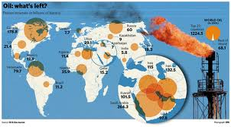
Political Factors
World politics are one of the more volatile factors that affect the oil trade, and prices at the pump
1
2
3
Notes:
Petroleum politics have been an increasingly important aspect of diplomacy since the rise of the petroleum industry in the Middle East in the early 20th century. As competition grows for an increasingly scarce but vital resource, the strategic calculations of major and minor countries alike place more prominent emphasis on the pumping, refining, transport and use of petroleum products.

Slide 21
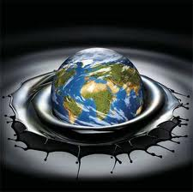
Political Factors
World-wide effects:
  Venuzuela, December 2002: general strike wipes out two months of oil production
  Iraq, March 2003: invasion of Iraq drops production from 2.5m to 500K b/d
  Nigeria and Russia: politics interrupts and reduces oil supplies
Notes:
Today's high oil prices are rooted in Venezuela's general strike of December 2002. The strike wiped out two months of exports and has permanently cost Venezuela's production capacity about 500,000 b/d. End-February 2003 OECD industry stocks hit a 20-year low ahead of the invasion of Iraq in March of that year. Iraqi oil production averaged 2.5m b/d in January/February 2003 but only 500,000 b/d in March-July 2003. Like Venezuela, its effective oil production capacity is now about 500,000 b/d less than it used to be. Politics has since interrupted and substantially reduced Nigerian and Russian crude oil supplies. Against this background world oil demand growth accelerated from 500,000 b/d in 2001 to a 26-year high of more than 2.5m b/d in 2004. From then until recently, OPEC has been struggling to extract every barrel of crude oil possible.

Slide 22

Political Factors
Parties within the US disagree about what to do with our oil reserves, developing renewable energy, and becoming energy independent.
1
2

Slide 23

Other Factors
Taxation
  Takes take up a significant portion of what makes up the price of a gallon of gas
  Varies from state to state and locally
Local market conditions
Competition between providers
Foreign exchange
Geographic location

Slide 24
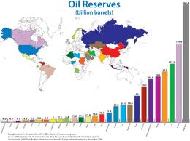

Slide 25
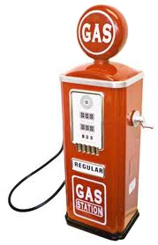

Conclusion
With so many factors affecting the price of oil, gas prices will continue to fluctuate

